Slide 1

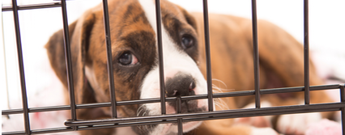
Shelter Animal Outcomes
IST 652 – Scripting for data analysis
Brandon croarkin

Slide 2
Data
Kaggle – from the Austin Animal Center from October 1st, 2013 to March, 2016
https://www.kaggle.com/c/shelter-animal-outcomes/data
BLS – Austin-Round Rock, TX Total Nonfarm employment, in thousands
https://www.bls.gov/bls/proghome.htm#employment

Slide 3
Data Fields
DateTime
OutcomeType
OutcomeSubtype
AnimalType
Breed
Color
Neutered
Gender
Age
Employment

Slide 4
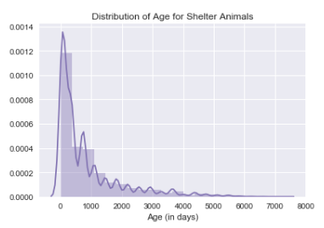
Analysis: Distribution of ages for shelter animals
Mean: 2.2 years old (819 days)
Median: 1 year old (365 days)

Slide 5
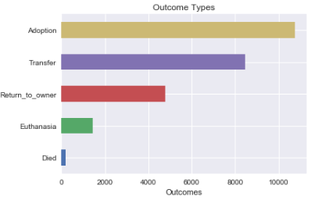

Analysis: What are the different outcome types for shelter animals and their frequency?

Slide 6

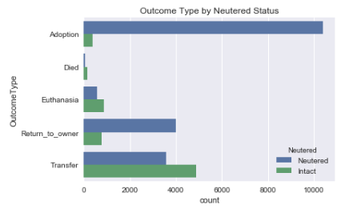



Analysis: Does shelter outcome differed based on neutered status?

Slide 7
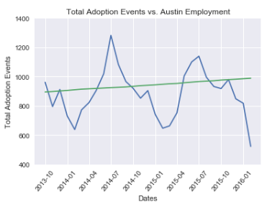
Analysis: Is there a relationship between adoption events and employment in Austin?
Slow, steady increase in Austin employment over time
Cyclical nature to adoption events (includes all outcome types)
Appears to be slight increase in total adoption events over time, although there is a drop-off at end of chart

Slide 8
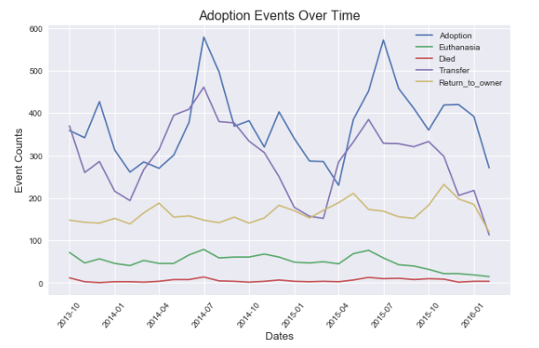
Analysis: Is there a trend in adoption events over time?
There is a drop in Euthanasia that occurs around June 2016
There is a clear seasonal nature to adoption, with adoptions spiking in July

Slide 9
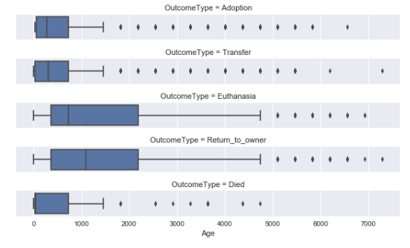
Analysis: How do outcomes differ across animal ages?
- There is a clear difference in animal ages for those that are euthanized and returned to owner, with the mean age and spread of ages being much larger.
- The low mean age of animals that died indicate that these are random events that would be hard to predict

Slide 10
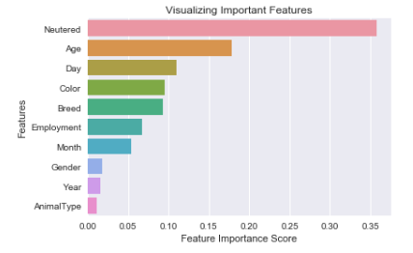
Predictive Analytics: How accurately can an animal’s adoption status be predicted?
After just focusing on ‘Adoption’ vs. ‘Euthanasia’ the ability of the random forest model to predict the outcome with 93% accuracy!
Most important features:

Slide 13
Questions
???

